Slide 1


ALL-IN-ONE Platform For Private Lesson
TEAM_D
Seunghwan-Lee Chaeyeon-Lee Moonhee-Park Jaeyoon-Jung

Slide 2
Table of contents
1
Final Proposal Feedback
2
Technical Background
3
Schedule
4
Role
5
User flow
6
Survey

Slide 3
Part 1
Final Proposal Feedback
The fact that teachers, students, and parents can
all receive appropriate features.
Q. What is the biggest advantage of
this platform compared to others?
A. Yes, that’s correct.
However, this is a competency expected of teachers,
So it is not considered an additional burden.
Q. Is it correct that the teacher has to input all assignment reports or exam scores?
Yes, that’s correct.
Only focuses on the lesson process.
Q. Is it correct that there is no function
for matching tutors and students?

Slide 4
Part 1
Final Proposal Feedback
Yes, there is. However, real-time communication
like KakaoTalk is not supported, but feedback for records, such as summaries of today's class or announcements, will be documented.
Q. Is there a feedback function? (Feedback: summary of today's class, class announcements, etc.)
A. Yes, the features differ based on the user roles
Q. Do users choose their roles when creating an account?
If so, are there differences in functions or permissions by role?

Slide 5
Part 1
Final Proposal Feedback
Parental involvement is not mandatory.
The platform is designed for convenience, allowing free participation.
However, for elementary, middle, and high school students, teachers may recommend parental participation based on their discretion.
Q. If parental involvement is necessary, what about adult students
(for exam preparation or other certifications)?
Q. What if a parent cannot participate?
Q. It might also be good to consider cases where a student takes multiple tutoring classes, not just the situation where a teacher manages several students.
A. Thank you for the great suggestion!

Slide 6



Part 2
Technical Background
요소1
Docker
MySQL
Figma

Slide 7




Part 2
Technical Background
요소1
CSS
Django
GitHub
Notion

Slide 8
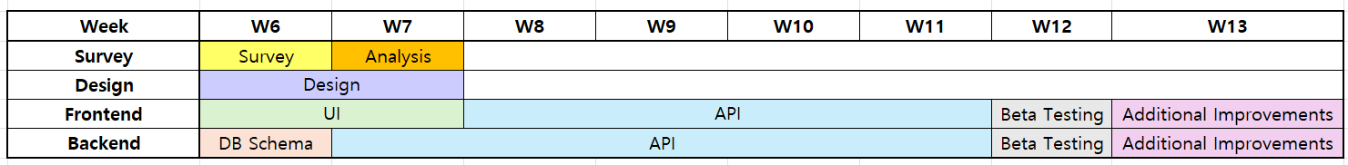
Part 3
Schedule

Slide 9
Part 4
Roles
Jaeyoon-Jung
Moonhee-Park
Survey Management
Slides
Figma support
User flow
Figma support
Seunghwan-Lee
Chaeyeon-Lee
Figma Management
Project Manager
Notion management
Bi-Weekly(1) Composition
Development initial set-up

Slide 10
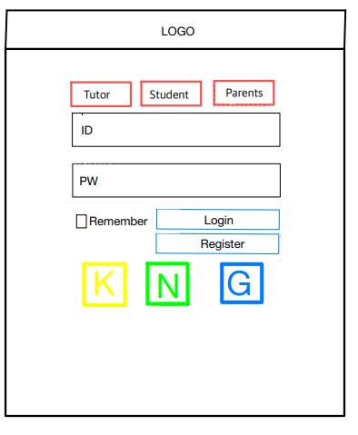
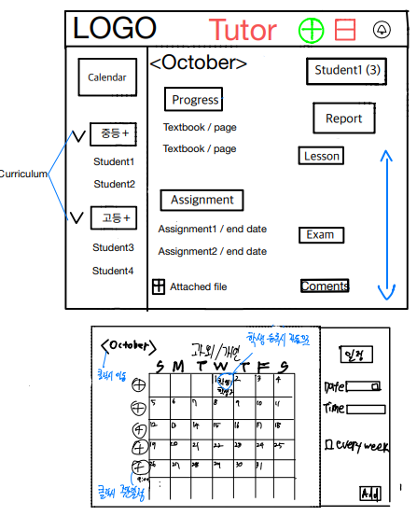
Part 5
User Flow

Slide 11
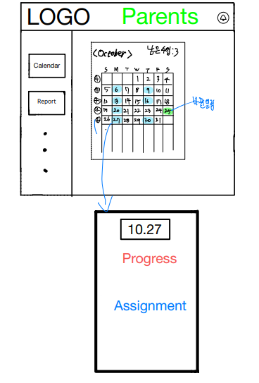
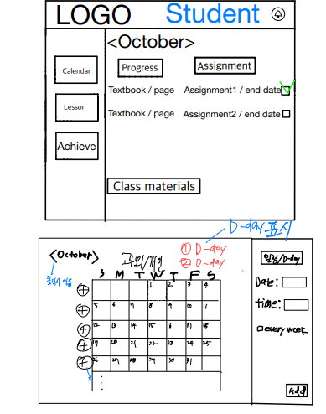
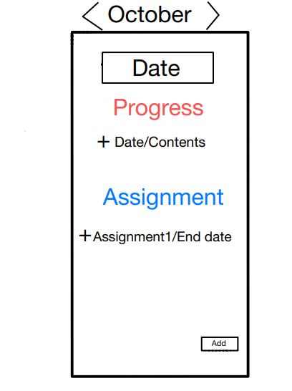
Part 5
User Flow

Slide 12
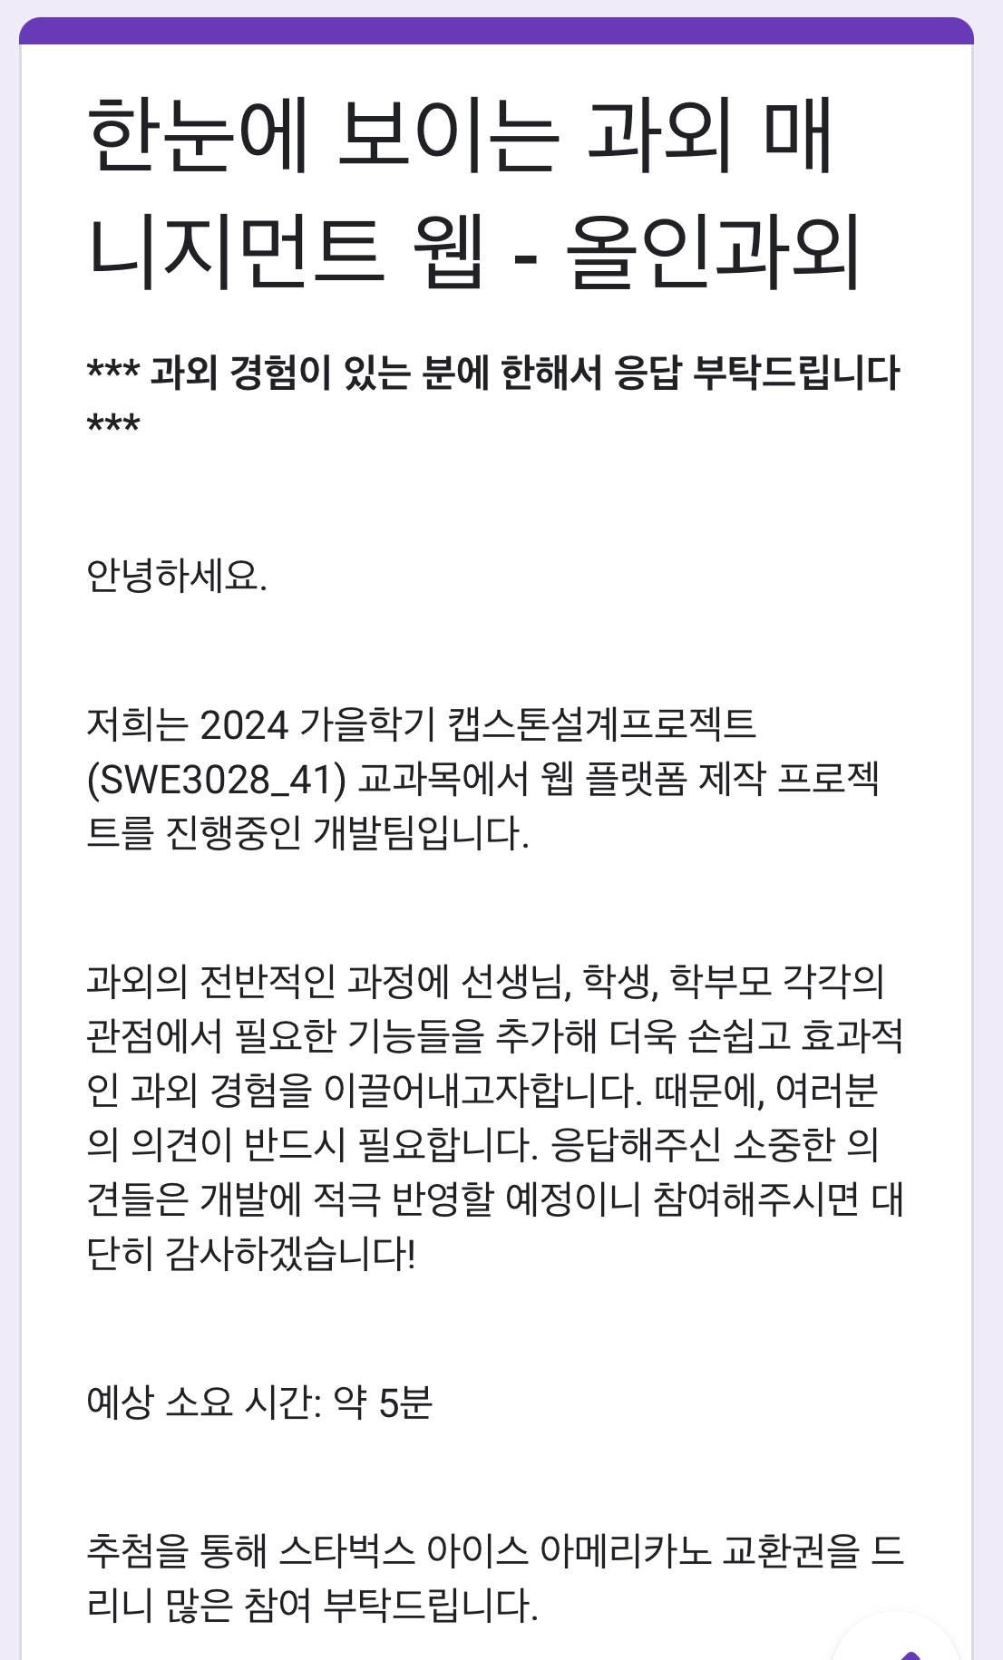
Part 6
Survey

Slide 13
Part 6
Survey _ Tutor
요소1

Slide 14
Part 6
Survey _ Tutor
요소1

Slide 15
Part 6
Survey _ Tutor
요소1
Hard to remember assigned homework
- Sense of unease when checking
Constraints of supplements
Especially with school exams
Have to prepare all by myself
Managing Multiple Excel Files
- Class schedule, curriculum, progress, tuition fee

Slide 16
Part 6
Survey _ Student
요소1

Slide 17
Part 6
Survey _ Any expected features?
Easy looking UI
Progress Report
Shared Calendar with my student
Point Penalty (just like a game)
if you don’t do your homework
Detailed grade management
(average? Improvement based on problem types?)
Self-assessment of weak points
(AI) Mapping personal Problems & solutions
for self-analysis
Progress Report – for parent counseling

Slide 18

THANK YOU

